Slide 1
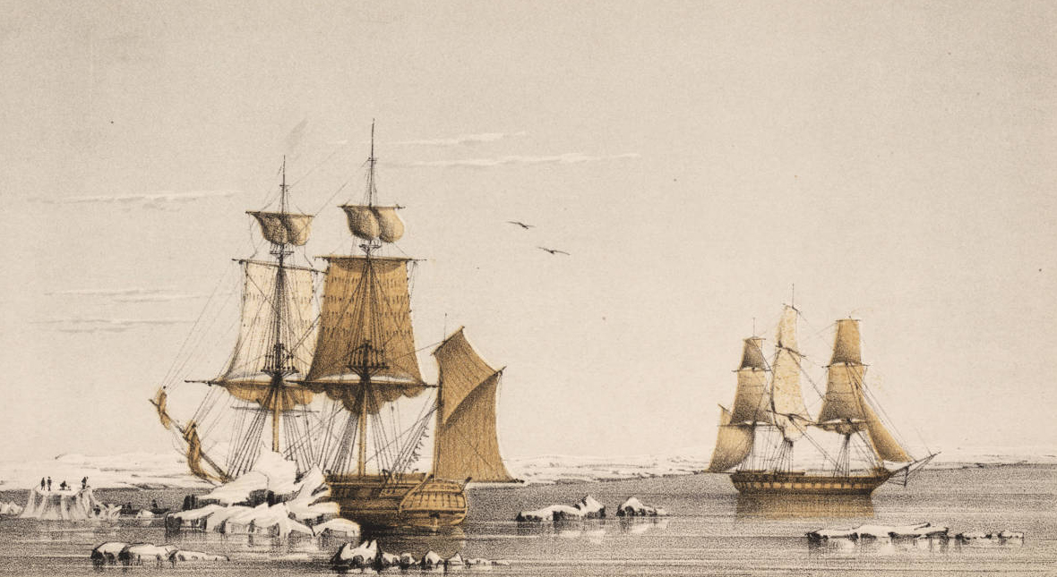
ACRE education and outreach with Commack High School:
The HMS Plover historical data intercomparison project
1852–1854
A. Ferreira
A. Francis
R. Kurtz
G. Shaw
K. Wood
T-J. Young
Image courtesy of the Linda Hall Library of Science and Technology
1

Slide 2
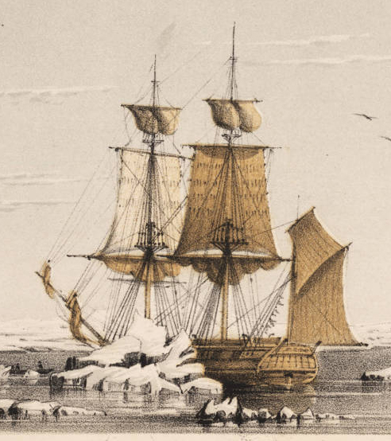
Weather observations at Point Barrow: 1852–1854
The surgeon and officers of the HMS Plover kept detailed records of the weather at Point Barrow from 1852 to 1854, including an hourly register of air temperature.
This is the earliest instrumental times series of any length from this part of the Arctic.
2

Slide 3
What do we know about the HMS Plover temperatures?
Measurement without standard exposures
Calibration at low temperatures uncertain
Other sources of bias and error
These are common problems
Hard to interpret in modern context
3

Slide 4
Students can find out cool stuff by experiment
Build a replica of the Plover thermometer screen
Install at modern observatory near Plover’s location
Estimate bias due to the old screen design
Apply to historical measurements and evaluate
4

Slide 5
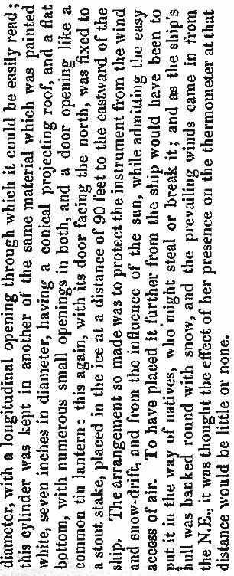
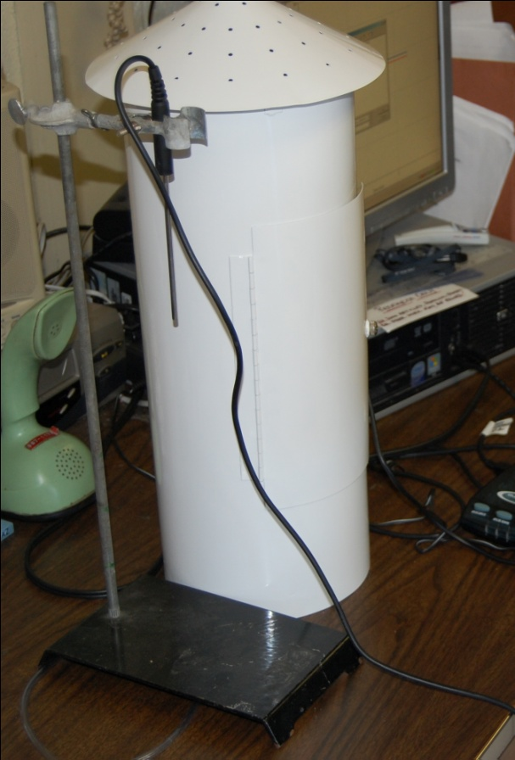
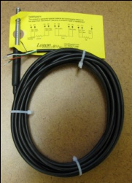
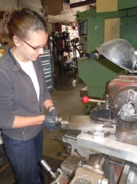
Reconstructing the Plover’s thermometer screen
Metadata from Dr Simpson’s Thermometrical Observations
at Point Barrow (1857).
Replica screen in the lab at Commack High School. Equipped with modern platinum resistance thermometer.
JISAO intern Vivian Underhill installing the platinum resistance thermometer at G-Machine.
5

Slide 6
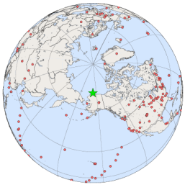
The Plover project at the NOAA Barrow Observatory
Plover screen
The Plover project will collect data for about one year. Data will be available via ftp in parallel with standard weather data from the Observatory.
NOAA’s atmospheric baseline observatory at Barrow, Alaska
6

Slide 7
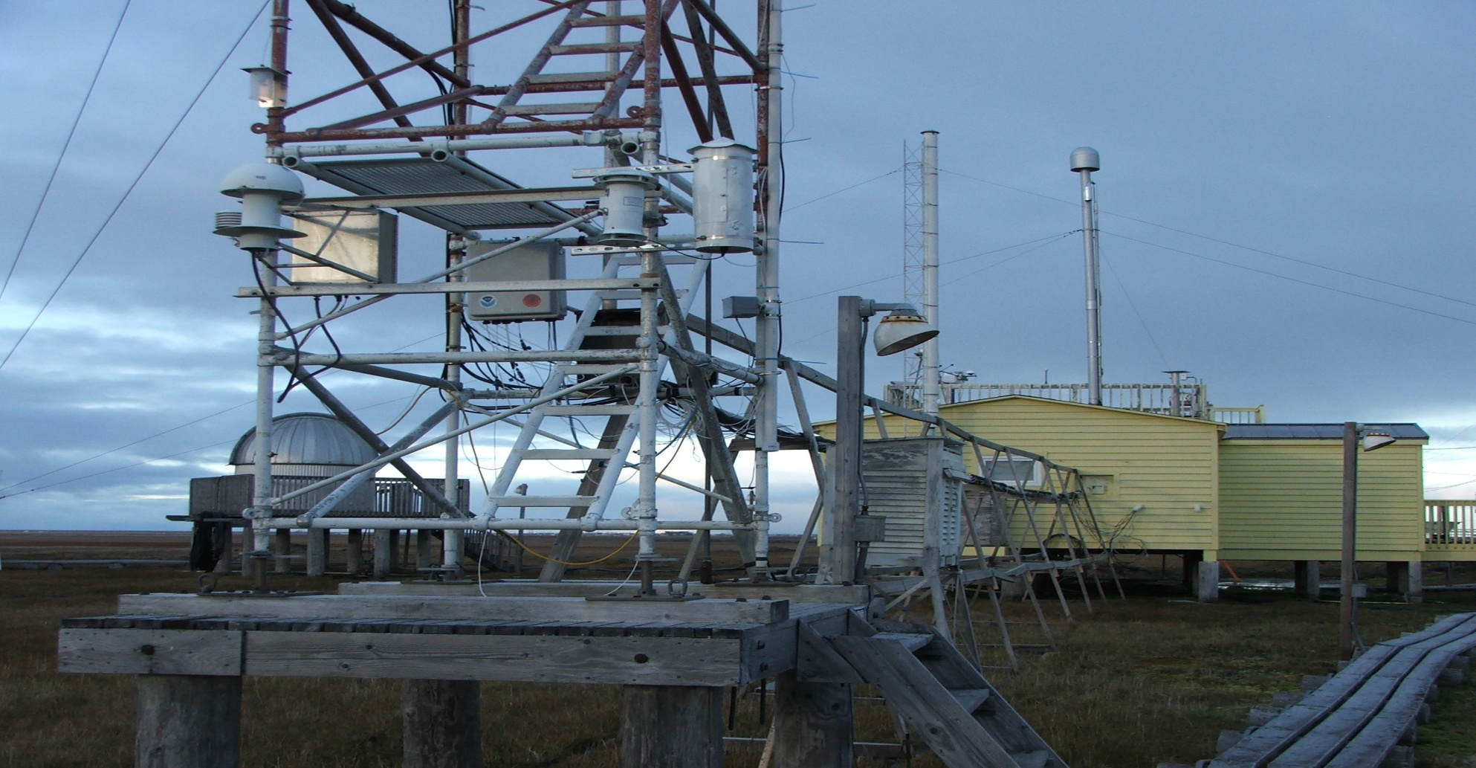
The Plover project at the NOAA Barrow Observatory
Thermometer Screen
The Plover project will collect data for about one year. Data will be available via ftp in parallel with standard weather data from the Observatory.
NOAA’s atmospheric baseline observatory at Barrow, Alaska
6

Slide 8
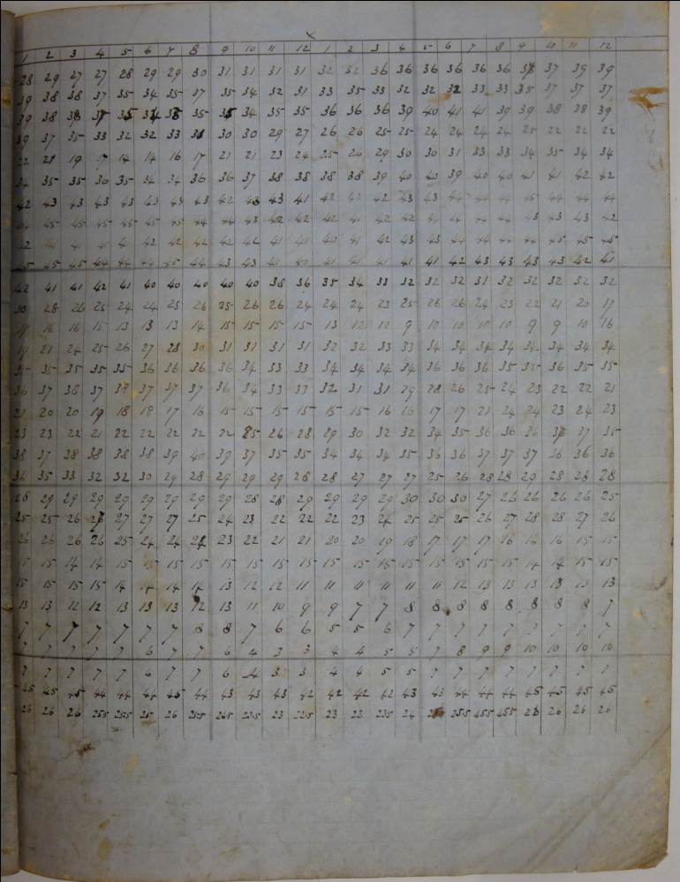
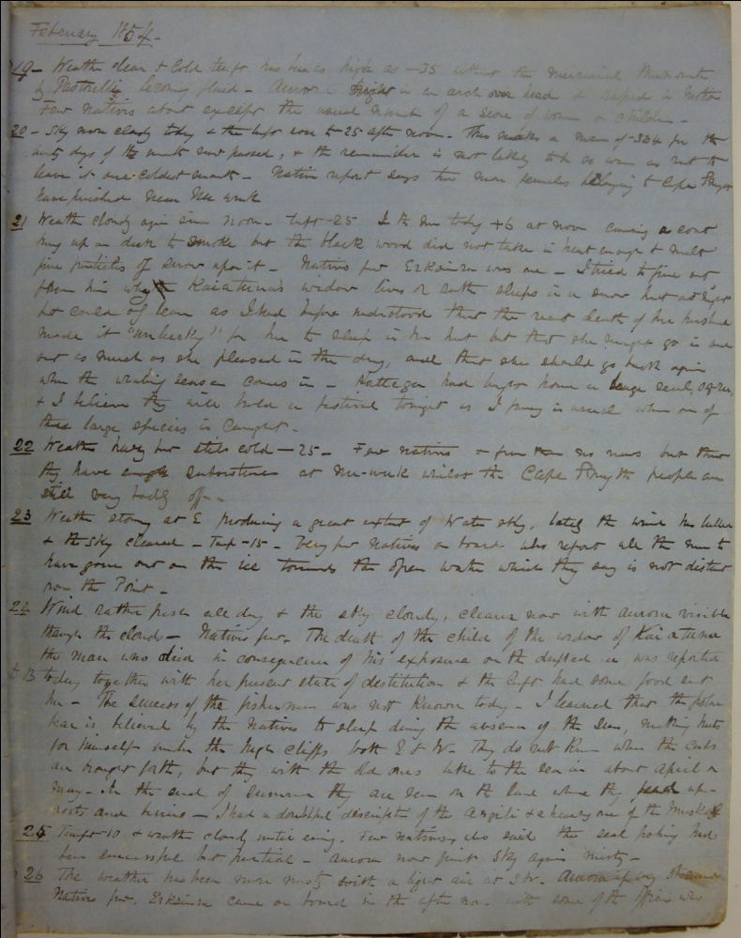
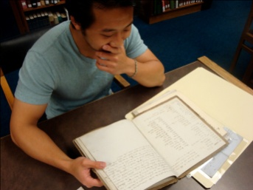
A trove of Plover records at Duke University
Dr. Simpson’s hourly temperature log and personal journal for February 1854 (also Met. Abstract)
Duke University student T-J Young at work in the Special Collections Library
7

Slide 9
Progress to date
Science plan outlined
Replica screen built and installed at Barrow Observatory
4 GB of Plover records photographed at Duke University
Transcription underway at Commack High School
First look at parallel data from the Observatory
8

Slide 10
Lots of material and in-kind support
NOAA Arctic Research Program / CPO
NOAA Climate Monitoring Division / Barrow Observatory
North Pacific Research Board
Joint Institute for the Study of the Atmosphere and Oceans (JISAO)
Duke University Marine Laboratory
Logan Enterprises, Inc.
TechniMetal Corporation
G-Machine
9

Slide 11
Plover project from an E-O point of view
Opportunity to engage young students in real science
Individual / tailored / collaborative mentoring
Draws interest of funders and educators
Does not impact large numbers (except example)
No broadly applicable curriculum development
10

